Slide 1
Introduction
This presentation was prepared for the Institute of Education Sciences (IES) under Contract ED-IES-17-C-0004 by the Regional Educational Laboratory (REL) Appalachia administered by SRI International. The content of the presentation does not necessarily reflect the views or policies of IES or the U.S. Department of Education nor does mention of trade names, commercial products, or organizations imply endorsement by the U.S. Government.
The original version of the presentation can be found on the IES website here: https://ies.ed.gov/ncee/edlabs/projects/project.asp?projectID=6685
If you plan to use these slides to facilitate a training or professional development session, please retain this disclaimer at the beginning of the presentation, even if you choose to add your organization’s logo or revise the slides to meet the needs of your audience. In the occurrence that changes are made, please add a note that: Amendments to the original slides have been made as necessary in order to specifically address the purpose of this presentation.

Slide 2
Mindsets and Math
[Add your school name, date, and any other helpful information]
Notes:
Welcome, families, staff, and community members.

Slide 3
Why math?
Notes:
Key point: A strong foundation in math is important for students’ success in school and in life.
Recommended script: In the past, math was often taught as a set of rules to follow. That's not what math really is, or how we teach it today. Math is about puzzling over quantitative problems, trying multiple strategies, and finding solutions.
Having a strong foundation in math is particularly important for students’ success in school and in life.
(1 minute)

Slide 4
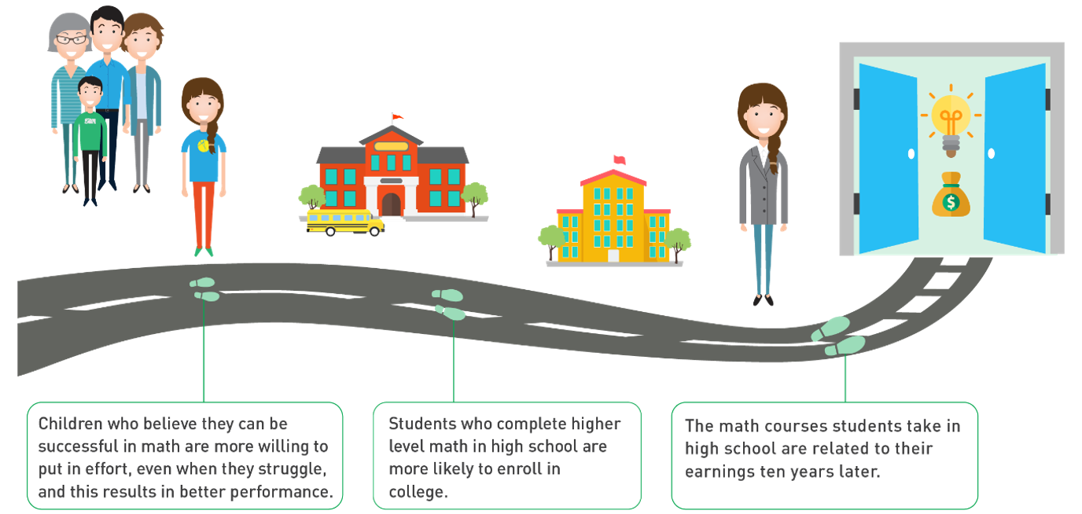
Math success opens doors to college and careers
Notes:
Key points: Students who do well in math at the elementary school level tend to perform better in math at the middle and high school levels, and also in other subjects. Taking advanced math courses can lead to higher incomes and more job opportunities.
Recommended script: Research demonstrates that children who believe that they can be successful in math tend to persist when challenged by a math problem, which in turn leads to better math performance. Students who perform better in math in elementary school are more likely to succeed in middle school and high school, in math and in other subjects. Taking advanced math courses in high school can lead to higher incomes and greater opportunities in a growing number of jobs.
(2 minutes)

Slide 5
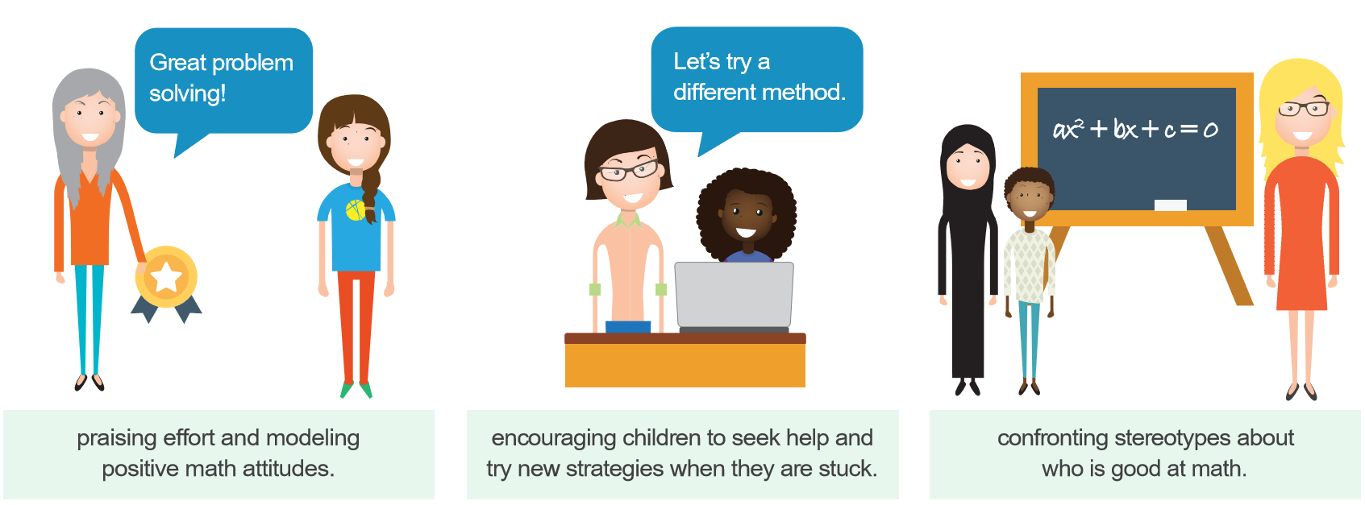
Families can support children in developing math skills
Notes:
Key points: Families are natural math role models for their children and can help children develop positive attitudes for learning math.
We want all families to understand the importance of math and feel comfortable and confident in supporting their children in learning math.
Recommended script: As families engage in home activities like cooking, grocery shopping, gardening, and woodworking, they serve as natural math role models and can invalidate stereotypes about who is good at math. Families can also model positive math attitudes and encourage children to try new strategies, persist through challenges, and seek help if needed.
So tonight, we want you to understand the importance of math and feel comfortable and confident in supporting your children in learning math.
(2 minutes)

Slide 6
Math attitudes and a growth mindset
Notes:
Recommended script: Before we get into the math activities, we think it is important to talk a bit more about how attitudes toward math can influence math learning.
(1 minute)

Slide 7
Adult attitudes toward math can influence a child’s math achievement
Multiple studies suggest that adults’ reactions to a child’s work will impact the child’s achievement and attitudes toward the subject.
When you have a negative attitude, children may feel you have low expectations of them, which can lead to lower motivation and lower expectations for their own success in math.
Notes:
Key points: Research has found that an adult’s reactions to a child’s work will affect the child’s achievement and attitudes toward the subject.
To help children develop positive attitudes toward math and to motivate them to learn math, adults should communicate their confidence in children as math learners, reinforcing their belief that all children can learn math.
Recommended script: When students are learning math, how we talk to them about math really matters. Research has found that an adult’s reactions to a child’s work will affect the child’s achievement and attitudes toward the subject. For example, if a child is learning something new in math and asks an adult for help, some adults might react by saying that they’re not good at math, or that they don’t know how to do the “new math.” While they might feel that way, it is important for them to think about what this communicates to the child. If the adult family member does not react positively, how can we expect the child to react positively?
In addition to paying attention to how we react when children ask for help with their work, we need to pay attention to how we communicate our expectations of them. When a child is struggling with math, a parent or teacher might try to comfort the student instead of offering strategies that help them succeed in math.
For instance, take the phrase we might all have heard: “I’m not a math person, but I did all right.” This communicates that you have low expectations of students in math, so why should the student try harder? Families can use phrases like “I know this is hard; maybe you can try another way to solve the problem?” or “I know this is hard, but you are learning something new, and sometimes that takes a lot of work.”
(3 minutes)

Slide 8
Math mindset matters
Fixed mindset
Growth mindset
  The belief that people are born with the intelligence they have and there is not much you can do to change it.
  The belief that people can increase their intelligence through hard work and persistence. You can work your brain like your muscles.
Notes:
Key point(s): Demonstrating a growth mindset, the belief that people can achieve more through hard work, can help children persist through learning challenges and recognize that anyone can learn math with the right support.
Recommended script: When we are engaging children in math, it is important to reflect on how we are approaching the subject and the attitudes we hold about math. We categorize these attitudes in two ways: a fixed mindset and a growth mindset.
When someone has a fixed mindset, she believes her accomplishments are based on some innate traits and that her successes are made with little to no effort and are based on her intelligence. People just are the way they are. Successful people are born to be successful. Math people are born to be math people.
With a growth mindset, people believe they have the ability achieve more through hard work. While intelligence and innate traits may play a part, success is a result of hard work, good strategies, and time spent on a task or subject. Successful people are not born, they are made.
Often, adults talk about the ability to learn math as something that is fixed within a child, possibly using phrases that sound reassuring, such as “You completed that problem because you are really smart” or “You're good at so many other things, maybe math just isn’t your subject.” However, these phrases are not a good way to encourage young children. They are promoting the fixed mindset. Phrases such as “You completed the most difficult problem. I bet you worked really hard at it,” or “I know you are struggling with math, maybe you need to try a new strategy/study method to get better” are phrases that promote a growth mindset.
The main message is that we want to praise children’s persistence in learning and to recognize that anyone can be a math person with the right support.
(3 minutes)

Slide 9

Encourage effort and learning
Not everyone is a math person; you’re so good at other subjects.
You can do it! Let’s try another strategy.
Notes:
Key point: Adults can help children develop a growth mindset for learning math through the words and phrases they use.
Recommended script: Now let’s look at some different phrases. Read each phrase on the screen and discuss it with the person next to you. Which one promotes a growth mindset?
It is important to notice the different strategies children are using to solve problems. You can ask questions such as:
What problem-solving skills did you use for this problem? Can you try a different strategy?
On a scale of 1 to 10, with 10 being the hardest you've ever tried to do something, how much effort did you put into this task?
(1 minute)

Slide 10
Praise effort and learning
You got a higher grade on this assignment. You must have worked really hard.
You got a higher grade on this assignment. You must be really smart.
Notes:
Key point: Help children recognize the connection between hard work and positive outcomes.
Recommended script: Let’s discuss these two phrases. They are more alike than the last two. Discuss with your neighbor: Which one do you think praises effort?
We should all tell our children that they are smart, but to emphasize a growth mindset, we want to make sure that we also praise effort and hard work.
Again, you can expand how you talk about your child’s effort to include questions such as “What do you think? Did you work hard?”
(1 minute)

Slide 11

Capitalize on the power of "yet"
I’m so disappointed! I worked really hard and still didn’t get an A on the assignment.
You didn’t get an A yet. You learned so much and are now more prepared for the next assignment. Ask your teacher for suggestions on how to improve.
Notes:
Key points: When children work hard and don’t achieve their desired goal, remind them of the power of “yet.” Children might not have reached their goal “yet,” but their efforts are bringing them closer to their goal.
Discuss the conversation between the parent and child shown on the slide and then share the message below.
Recommended script: All of us have experienced times when we worked hard to achieve a goal and still fell short of the goal. It can be disappointing and can shake a person's confidence. When your children experience disappointing outcomes, even when they have worked hard, help them capitalize on the power of "yet," reminding them to think about the progress they’ve made and about how to improve (ask for help, do extra practice, try another study strategy). Helping children develop resilience when faced with disappointments provides life lessons beyond the classroom.
(2 minutes)

Slide 12

Take home messages
Adult attitudes toward math can influence a child’s math achievement.
Family and teacher feedback is important for math learning.
Providing growth-oriented feedback can help your children succeed at math.
Praise effort and learning!
Notes:
Key point(s): Share the take-home messages on the slide.
(1 minute)

Slide 13
References
Achieve, Inc. (2006). Closing the expectations gap: An annual 50-state progress report on the alignment of high school policies with the demands of college and work. https://www.achieve.org/files/50-state-06-Final.pdf
Blackwell, L. S., Trzesniewski, K. H., & Dweck, C. S. (2007). Implicit theories of intelligence predict achievement across an adolescent transition: A longitudinal study and an intervention. Child Development, 78, 246–263.
Boaler, J. (2015). Mathematical mindsets: Unleashing students' potential through creative math, inspiring messages and innovative teaching. John Wiley & Sons.
Dweck, C. S. (2008). Mindsets and math/science achievement. https://www.growthmindsetmaths.com/uploads/2/3/7/7/23776169/mindset_and_math_science_achievement_-_nov_2013.pdf
Claessens, A., & Engel, M. (2013). How important is where you start? Early mathematics knowledge and later school success. Teachers College Record, 115(6).
Duncan, G. J., Dowsett, C. J., Claessens, A., Magnuson, K., Huston, A. C., Klebanov, P., Pagani, L. S., Feinstein, L., Engel, M., Brooks-Gunn, J., Sexton, H., Duckworth, K., & Japel, C. (2007). School readiness and later achievement. Developmental Psychology, 43(6), 1428–1446. https://doi.org/10.1037/0012-1649.43.6.1428
Epstein, J.L. (2001). School, family, and community partnerships (1st ed.). Westview Press.
Siegler, R. S., Duncan, G., Davis-Kean, P. E., Duckworth, K., Claessens, A., Engel, M., Susperreguy, M.I., & Meichu, C. (2012). Early predictors of high school mathematics achievement. Psychological Science, 23(7), 691–697. https://eric.ed.gov/?id=ED552898

